Slide 1
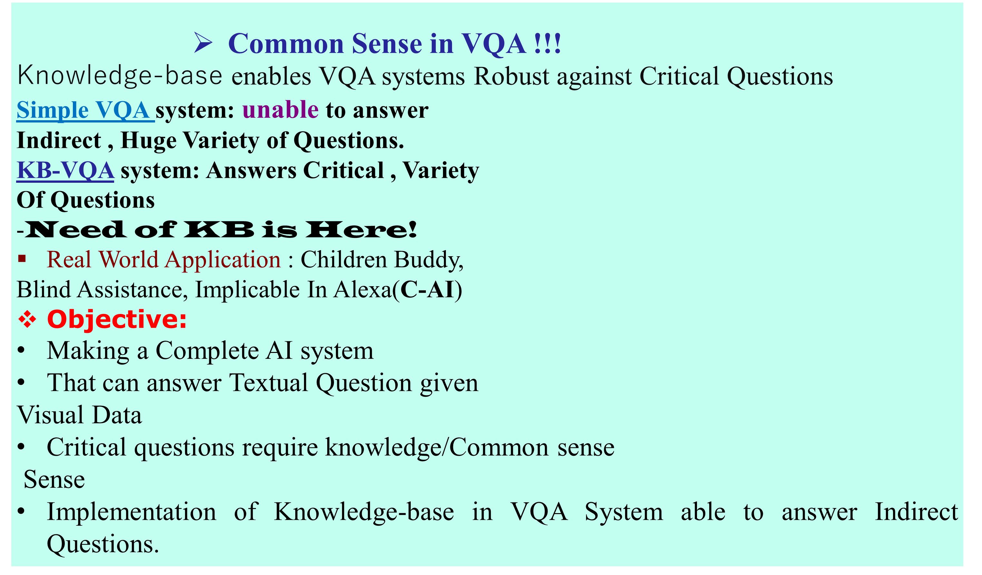

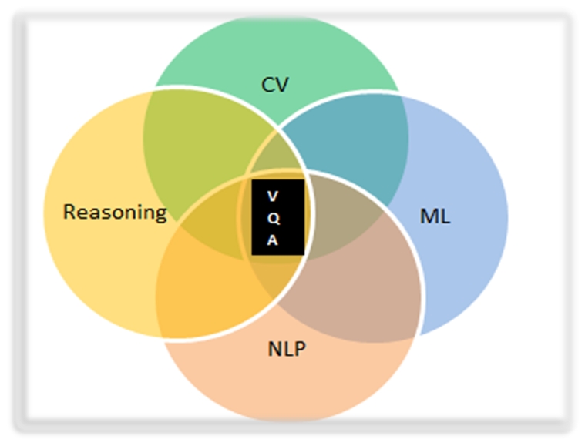
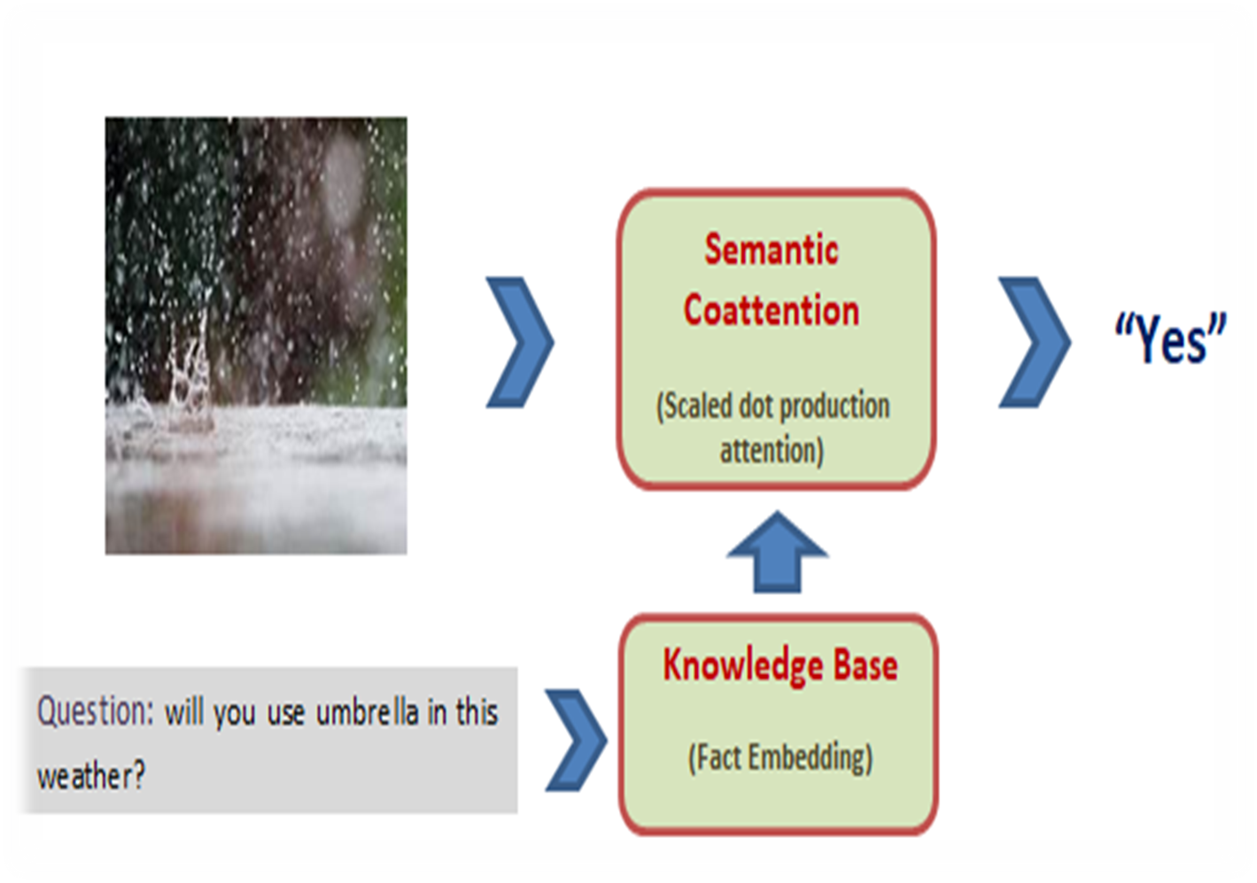
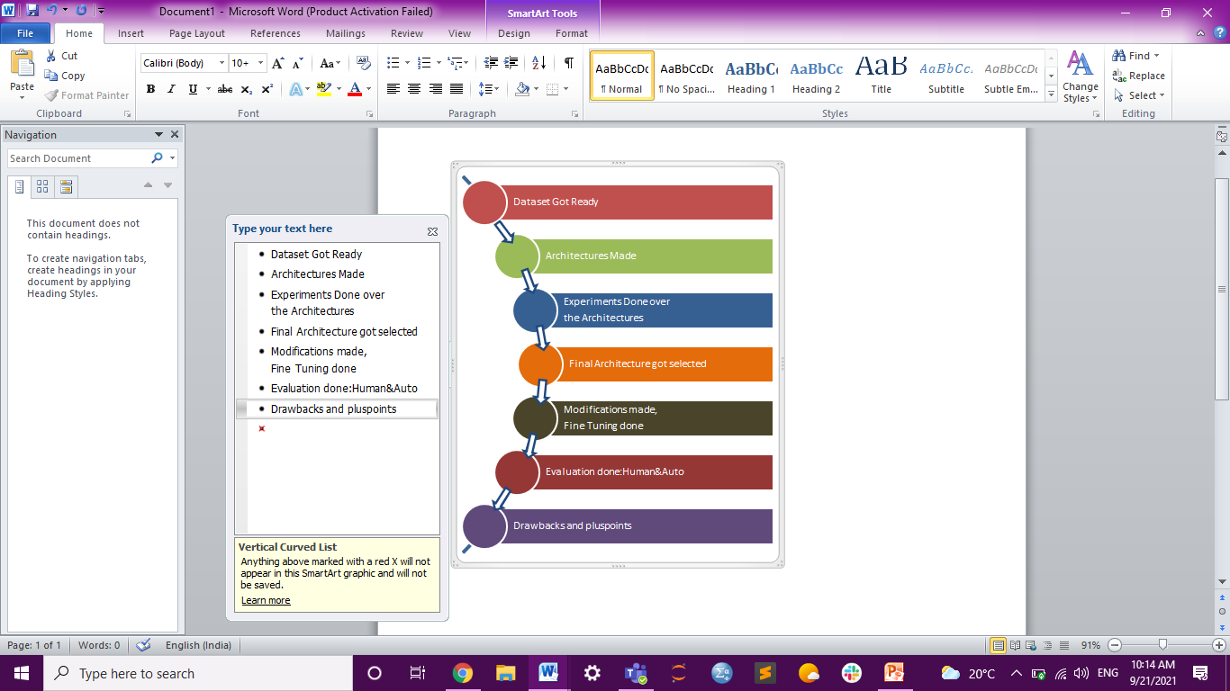
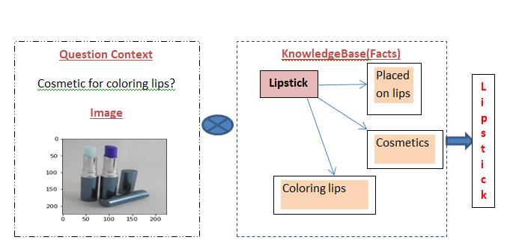
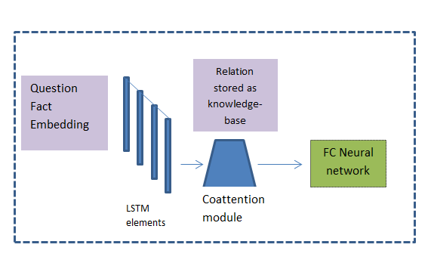
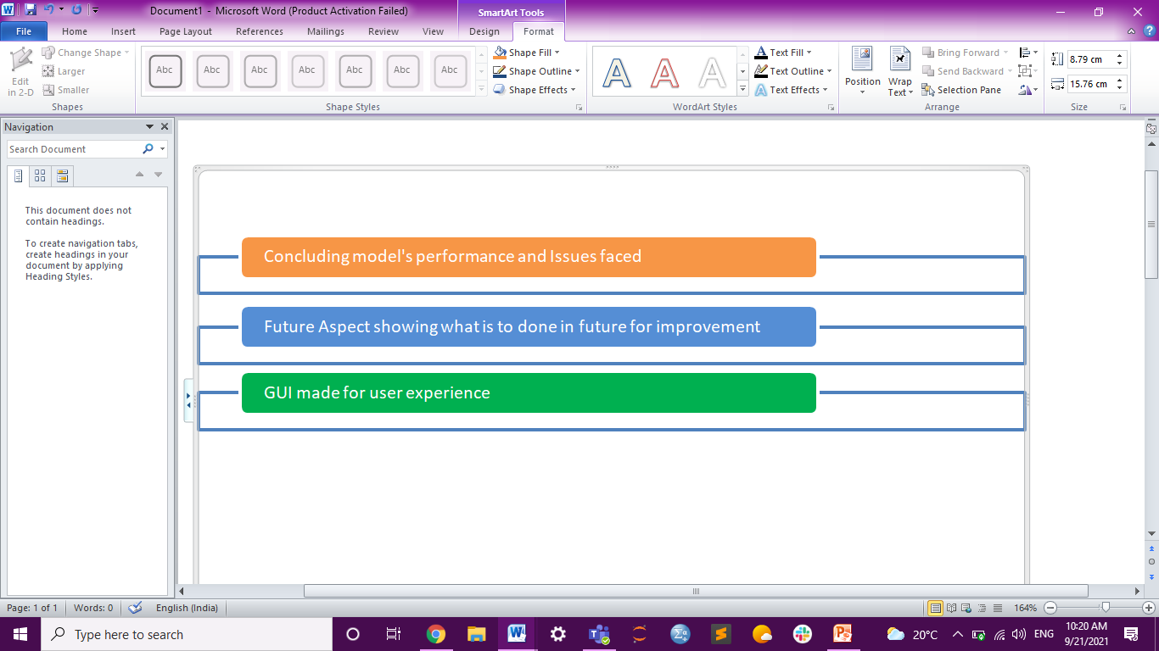

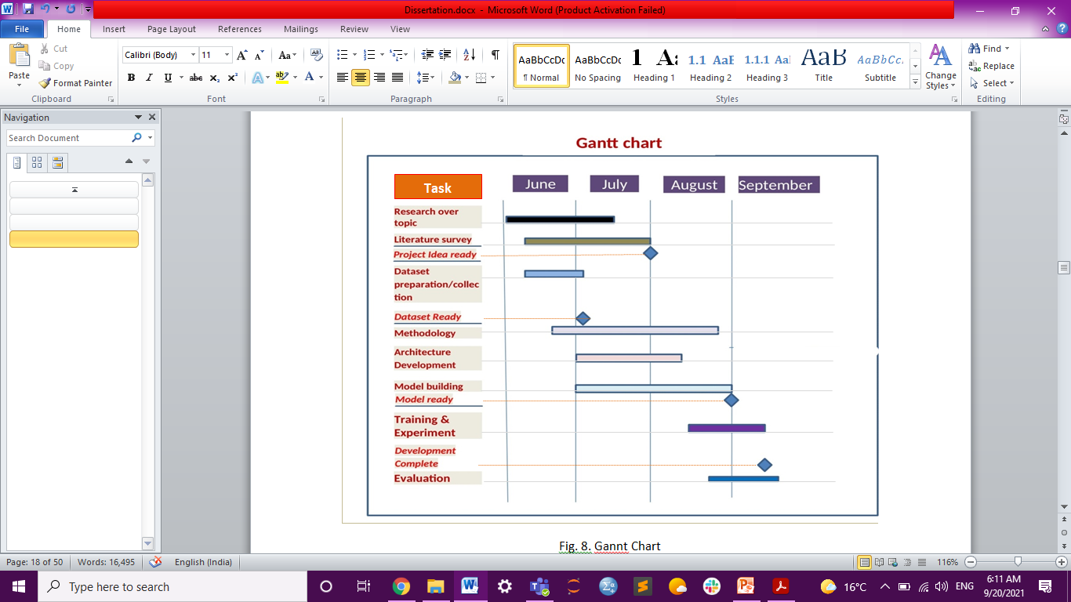
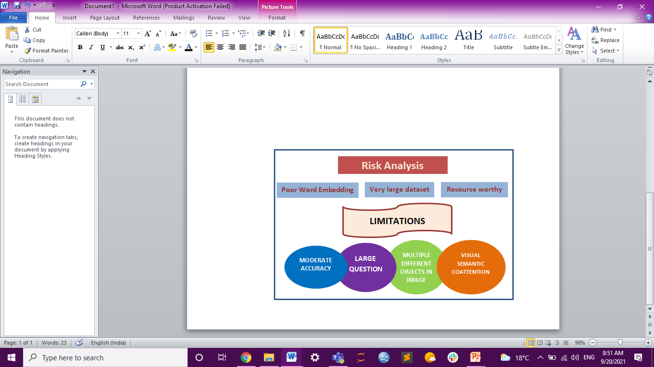

‘KB’ Helping ‘VQA’ Answer Indirect Questions
Ayandeep Kundu
Id:25360019 | University of Lincoln
Extension Authorisation Code: ZSYZZS4DP2Q7TVWS
Ayandeep Kundu
Computer Science; University Of Lincoln
A b s t r a c t
I n t r o d u c t I o n
VQA Answering Critical Question
Visual Question Answering(VQA):
Multimodal System Combining
Computer Vision, NLP, Reasoning
and ML
Question(Q) and Fact(F) embeddings merged together
Semantic Coattention module Stores Q-F relation information as Knowledge-base(KB).
Semantic Coattention module gives KB support.
Visual and Q-F Relation helps In Prediction
Expectation: ~60% accuracy ; ~52% accuracy reached
ROC curve, Wu-pulmer Similarity, Auto and Human guided evaluation for performance testing
Project Plan
Research Methods
Joint embedding with Attention module
Question-Fact Joint Embedding with Attention mechanism.
LSTM elements with Semantic Attention module gives KB to the model
Attention Mechanism pays more focus deriving keywords fed to FC neural network
Visual Features fed to NN helps the model choose correct relation (KB info)
Relation Information Plays KB role here
52% accuracy reached so far
Drawback: Image model takes higher re-
-soution object under consideration
From VGG-16 last layer image features collected
Question ,Fact embeddings created by GloVe and Embedding layer
Semantic Attention module stores relation as KB
Relation Information and Visual features fed to FC neural network
Wu-Palmer ,Semantic similarity, Human &Auto Evaluation for performance Analysis
Future Extension : Semantic attention over Image model, Transformer Implementation
Evaluation methods/metrics
Wu-Palmer similarity (measure of answer-label similarity )
Semantic Similarity
Automatic Quantitative evaluation
Human guided Evaluation score
ROC curve (False positive VS true positive estimation)
Module Code : Research Project
  CMP9140M - 2021

